Slide 1


St. MARTIN’S ENGINEERING COLLEGE
UGC Autonomous
NBA & NAAC A+ ACCREDITED
Dhulapally, Secunderabad– 500100
Department of Computer Science & Engineering
Mini Project on
REAL-TIME OBJECT TRACKING WITH VISION-BASED AI ANALYTICS
Batch No: 10
1. K.SAI VIGNESH REDDY (23K81A05M7)
2. M.SIDDU (23K81A05N3)
3. S.SRUJAN KUMAR (23K81A05P4)
4. P.MINIHAS (23K81A05Q8)
Under the Guidance of
Mrs. G.Bruhaspathi
Assistant Professor
Department of Computer Science & Engineering

Slide 2
OUTLINE
Title of the Project
Abstract
Detailed Design
Contribution of Candidate and Result Obtained
References
80% of code implementation

Slide 3
ABSTRACT
Real-time object tracking with vision-based AI integrates deep learning, computer vision, and real-time analytics to detect and monitor moving objects with high accuracy and low latency.
Using YOLOv8, CNNs, Flask, and OpenCV, the system enables real-time detection through webcam, image, and video inputs while handling occlusion, illumination changes, and complex backgrounds.
The system includes a Flask-based backend and live analytics dashboard displaying object count and FPS metrics, ensuring robust multi-object tracking.
The solution supports applications such as surveillance, traffic monitoring, industrial automation, and smart city systems requiring AI-driven real-time decision-making.

Slide 4
DETAILED DESIGN
The system follows a client–server architecture, integrating a Flask backend with the YOLOv8 deep learning model for real-time object detection.
The web client sends requests to the backend, which processes video frames using OpenCV and performs inference using YOLOv8 (yolov8n.pt).
Detected objects are processed with bounding box extraction, confidence filtering, and frame-wise tracking, ensuring accurate multi-object detection.
A dedicated Analytics Module computes object count and FPS metrics, which are returned via REST APIs and displayed on the real-time dashboard.
The modular design ensures scalability, low latency processing, and efficient resource utilization.

Slide 5
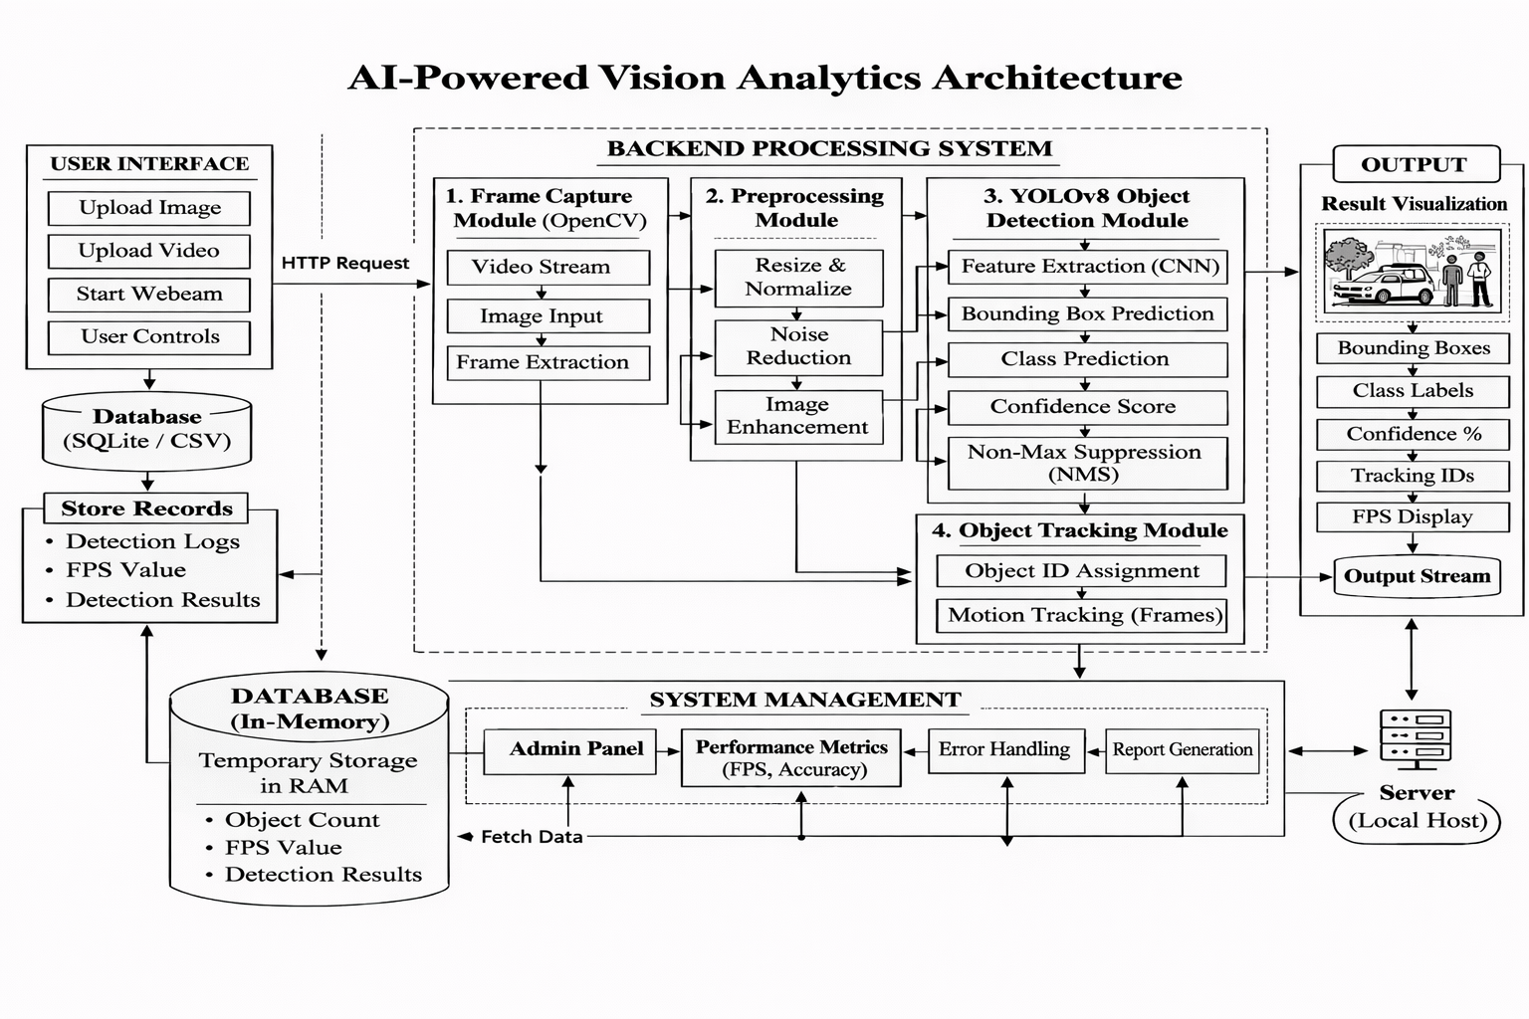
DETAILED DESIGN

Slide 6
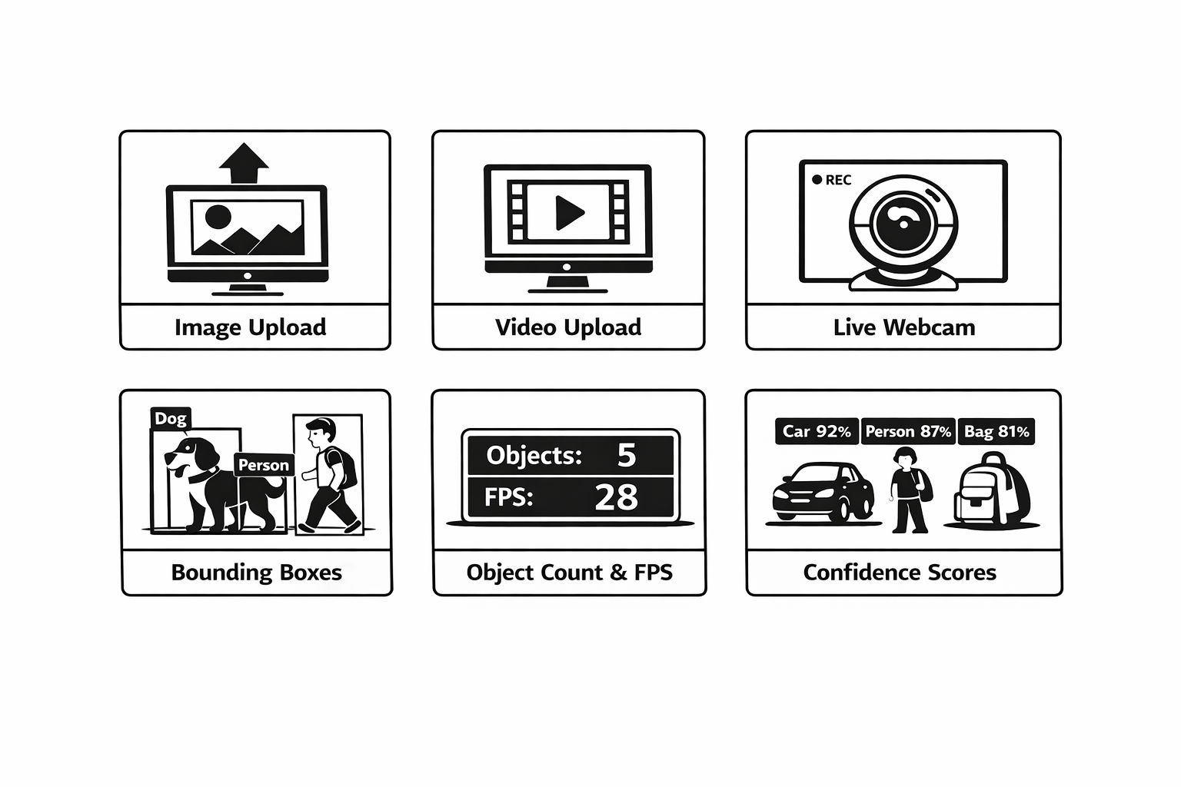
FEATURES

Slide 7
Contribution of Candidate and Result Obtained
Candidate 1– Srujan
Designed overall system architecture for Real-Time Object Tracking
Integrated YOLOv8 model with backend
Implemented core object detection logic using OpenCV
Optimized real-time image, video, and webcam processing
Coordinated team development and ensured successful integration
Designed PPT slides and review materials
Candidate 2 – Vignesh
Developed backend application using Flask
Integrated YOLOv8 model for detection
Implemented image, video, and live webcam tracking modules
Handled bounding box drawing and confidence score display
Connected frontend interface with backend detection system

Slide 8
3. Contribution of Candidate and Result Obtained
Candidate 3 – Siddu
Designed and implemented frontend UI Developed tracking simulation interface
Integrated frontend with backend APIs
Improved user interaction and system responsiveness
Assisted in testing and debugging
Candidate 4 – Minihas
Prepared complete project documentation and report formatting
Designed UML diagrams
Performed unit, integration, and system testing
Documented test cases and experimental results

Slide 9
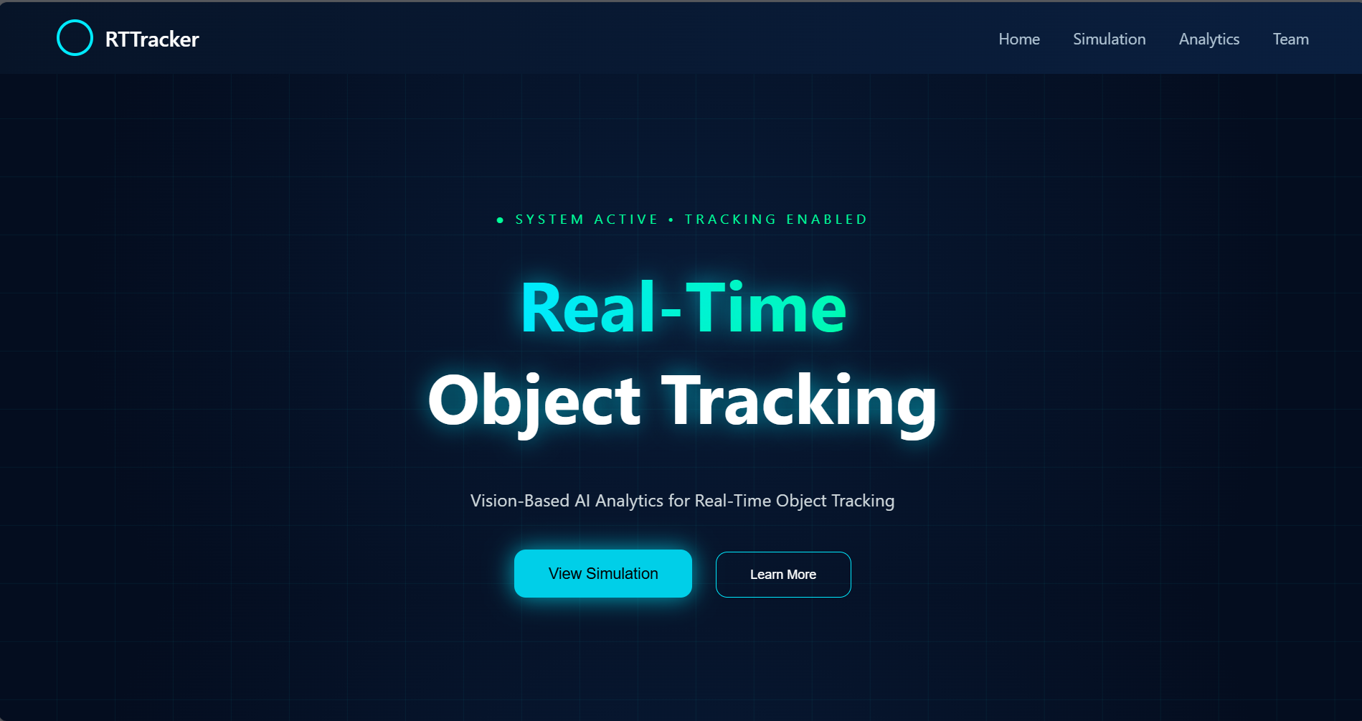
RESULT OBTAINED

Slide 10
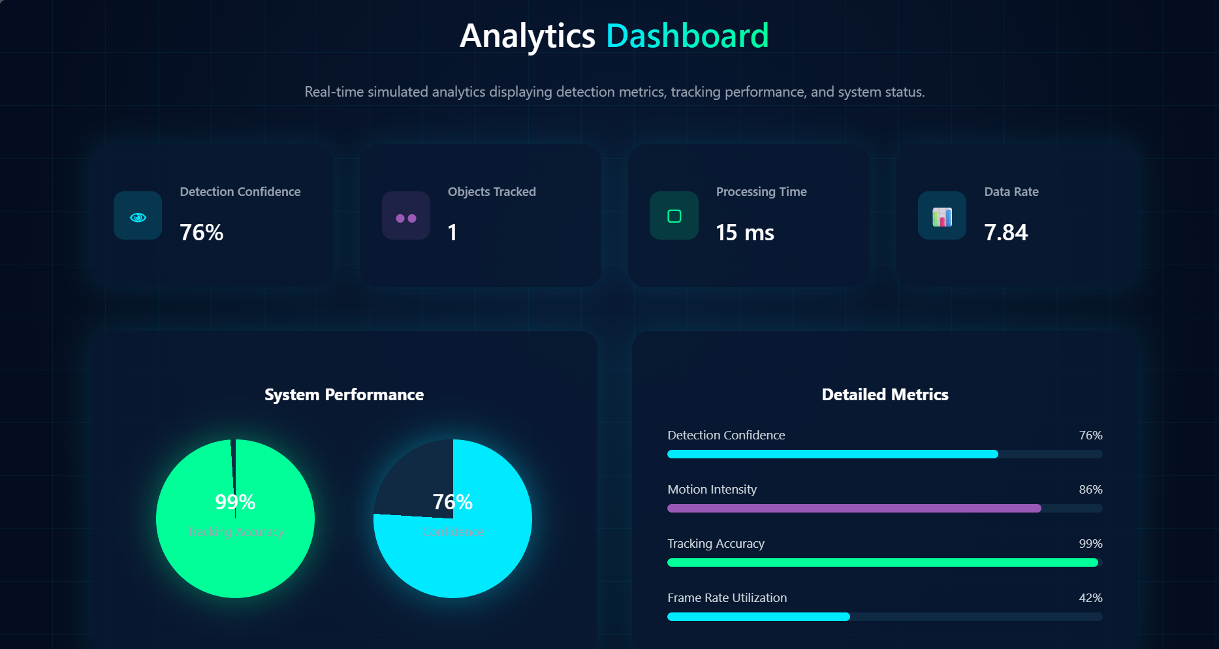

Slide 11
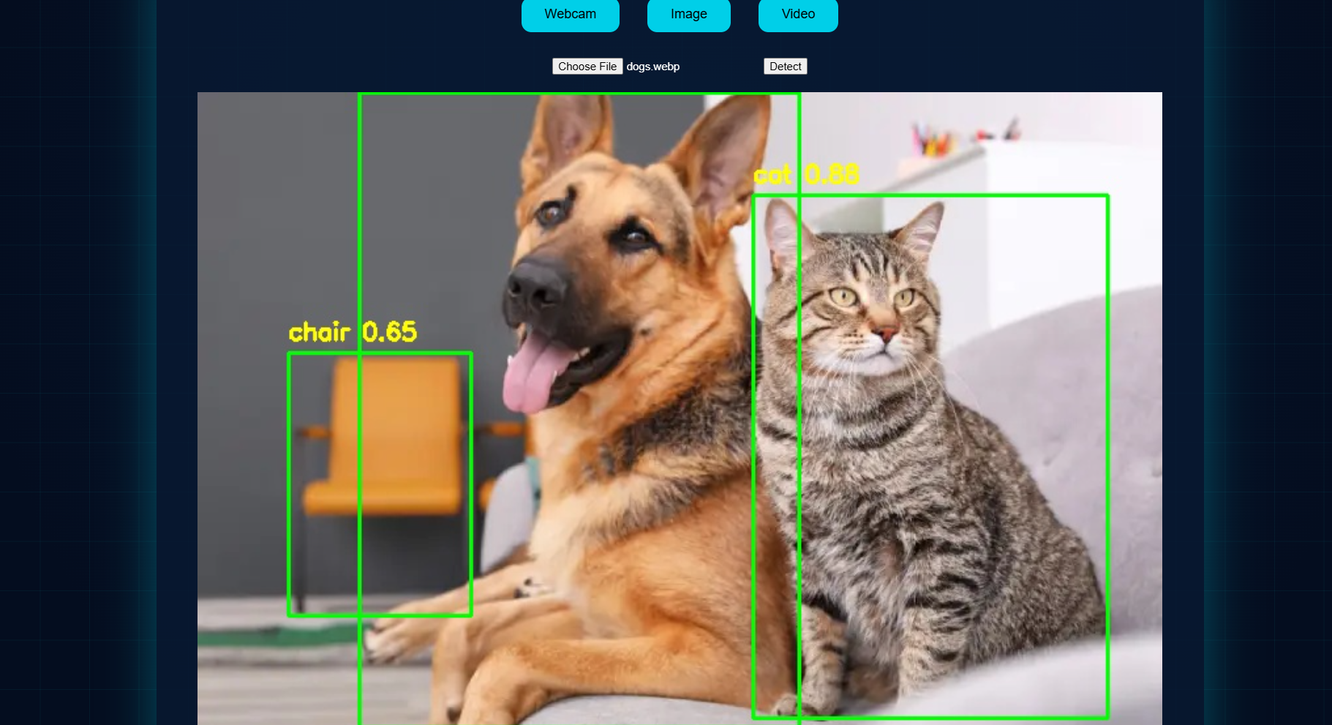

Slide 12
REFERENCES
Redmon, J., Divvala, S., Girshick, R., & Farhadi, A. You Only Look Once: Unified, Real-Time Object Detection. CVPR, 2016.
Redmon, J., & Farhadi, A. YOLO9000: Better, Faster, Stronger. CVPR, 2017.
Redmon, J., & Farhadi, A. YOLOv7: An Incremental Improvement. arXiv, 2018.
Bochkovskiy, A., Wang, C.-Y., & Liao, H.-Y. M. YOLOv4: Optimal Speed and Accuracy of Object Detection. arXiv, 2020.
Wang, C.-Y., Bochkovskiy, A., & Liao, H.-Y. M. YOLOv7: Trainable Bag-of-Freebies for Real-Time Object Detection. arXiv, 2022.
Ren, S., He, K., Girshick, R., & Sun, J. Faster R-CNN: Towards Real-Time Object Detection with Region Proposal Networks. NIPS, 2015.
Liu, W., Anguelov, D., Erhan, D., et al. SSD: Single Shot MultiBox Detector. ECCV, 2016.

Slide 13
REFERENCES
Lin, T.-Y., Dollár, P., Girshick, R., et al. Feature Pyramid Networks for Object Detection. CVPR, 2017.
Simonyan, K., & Zisserman, A. Very Deep Convolutional Networks for Large-Scale Image Recognition (VGG). arXiv, 2014.
He, K., Zhang, X., Ren, S., & Sun, J. Deep Residual Learning for Image Recognition (ResNet). CVPR, 2016.
Dai, J., Li, Y., He, K., & Sun, J. R-FCN: Object Detection via Region-Based Fully Convolutional Networks. NIPS, 2016.
Tan, M., & Le, Q. V. Efficient Net: Rethinking Model Scaling for CNNs. ICML, 2019.
Kingma, D. P., & Ba, J. Adam: A Method for Stochastic Optimization. arXiv, 2014.
Bewley, A., Ge, Z., Ott, L., et al. Simple Online and Realtime Tracking (SORT). ICIP, 2016.
Wojke, Bewley,& Paulus, D. Deep SORT: Deep Learning for Multi-Object Tracking. ICIP, 2017.

Slide 14
SOURCE CODE
from flask import Flask, render_template, Response, request, jsonify, send_from_directory
import cv2
from ultralytics import YOLO
import os
import time
app = Flask(__name__)
model = YOLO("yolov8n.pt")
camera = cv2.VideoCapture(0)
UPLOAD_FOLDER = "uploads"
os.makedirs(UPLOAD_FOLDER, exist_ok=True)
object_data = {}
fps_value = 0
# ---------------- WEBCAM ----------------
def generate_frames():
global object_data, fps_value
while True:
success, frame = camera.read()
if not success:
break
start = time.time()

Slide 15
@app.route('/upload_image', methods=['POST'])
def upload_image():
if 'image' not in request.files:
return jsonify({"error": "No file"}), 400
file = request.files['image']
path = os.path.join(UPLOAD_FOLDER, file.filename)
file.save(path)
image = cv2.imread(path)
results = model(image)[0]
for box in results.boxes:
x1,y1,x2,y2 = map(int, box.xyxy[0]) cls = int(box.cls[0])
label = model.names[cls]
conf = float(box.conf[0])
cv2.rectangle(image,(x1,y1),(x2,y2),(0,255,0),2)
cv2.putText(image,f"{label} {conf:.2f}", (x1,y1-10),
cv2.putText(image,f"{label} {conf:.2f}",
(x1,y1-10),
cv2.FONT_HERSHEY_SIMPLEX,0.6,(0,255,255),2)
output_path = os.path.join(UPLOAD_FOLDER, "output.jpg")
out = cv2.VideoWriter(output_path, fourcc, fps, (width, height))
while True:
ret, frame = cap.read()
if not ret:
break
results = model(frame, imgsz=320)[0]
object_data = {}
for box in results.boxes:
x1, y1, x2, y2 = map(int, box.xyxy[0])
conf = float(box.conf[0])
cls = int(box.cls[0])
label = model.names[cls]
object_data[label] = object_data.get(label, 0) + 1
cv2.rectangle(frame, (x1,y1), (x2,y2), (0,255,0),2)
cv2.putText(frame, f"{label} {conf:.2f}",
(x1,y1-10),
cv2.FONT_HERSHEY_SIMPLEX,
0.6,(0,255,255),2)
fps_value = round(1/(time.time()-start),2)
cv2.putText(frame, f"FPS: {fps_value}",
(20,40),
cv2.FONT_HERSHEY_SIMPLEX,0.8,
(0,255,255),2)
ret, buffer = cv2.imencode('.jpg', frame)
frame = buffer.tobytes()
yield (b'--frame\r\n’
b'Content-Type: image/jpeg\r\n\r\n' + frame + b'\r\n’)
@app.route('/')
def home():

Slide 16
results = model(fame, imgsz=320)[0]
for box in results.boxes:
x1, y1, x2, y2 = map(int, box.xyxy[0])
cls = int(box.cls[0])
label = model.names[cls]
conf = float(box.conf[0])
cv2.rectangle(frame, (x1, y1), (x2, y2), (0,255,0), 2)
cv2.putText(frame,
out.write(frame)
cap.release()
out.release()
@app.route('/analytics_data')
def analytics_data():
return jsonify({
"objects": object_data,
"fps": fps_value,
"total": sum(object_data.values())
})
if __name__ == "__main__":
app.run(debug=True)

Slide 17
QUERIES ??

Slide 18
THANK YOU!

